Slide 2
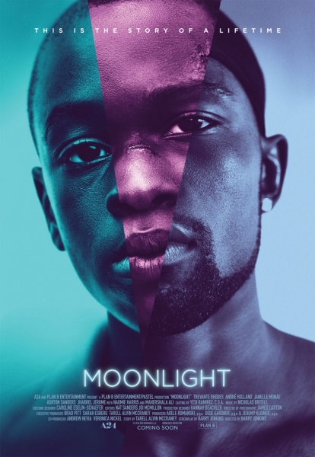
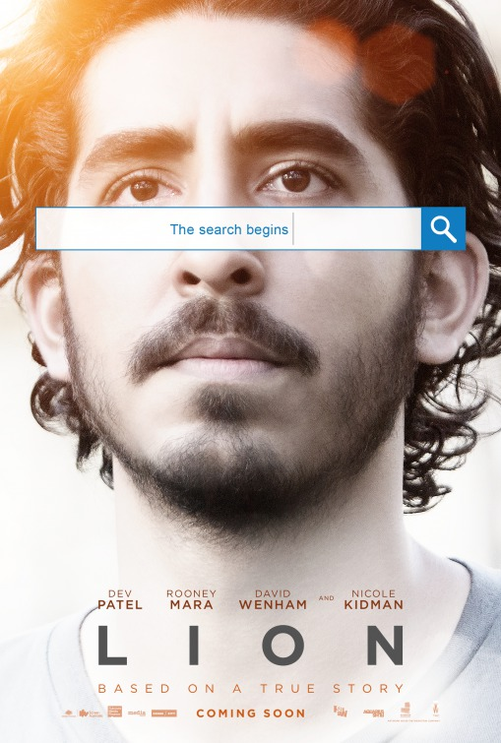
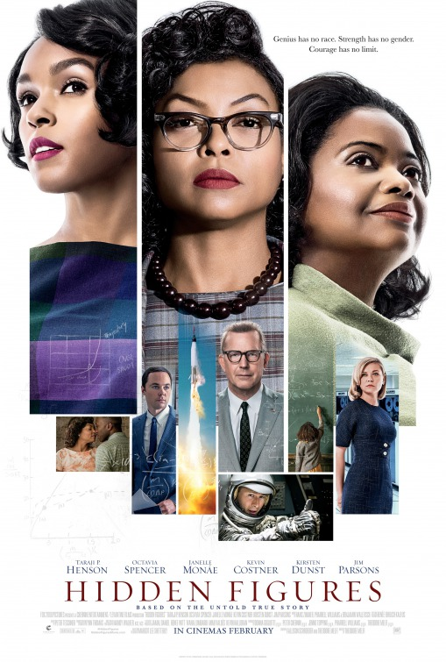
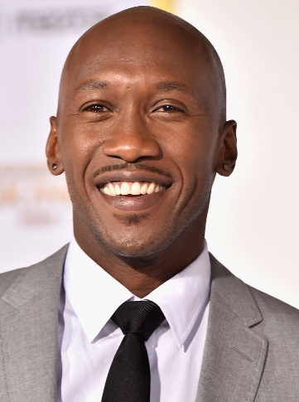
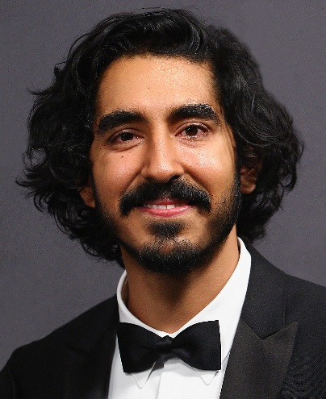
#OscarsNotAsWhite
Best Picture Nominees:
Best Director Nominee:
Best Actor/Actress Nominees:
Notes:
Acting: and then pics of Mahershala Ali ("Moonlight") and Dev Patel ("Lion") Viola Davis ("Fences"), Naomie Harris("Moonlight") and Octavia Spencer ("Hidden Figures"); Denzel Washington ("Fences"); and Ruth Negga ("Loving").
Directing: Barry Jenkins ("Moonlight")
Screenwriting: Barry Jenkins (again) and "Fences" screenwriter August Wilson
(if there is space)
Documentary: posters from "13th","I Am Not Your Negro", "O.J.: Made in America" "Life, Animated"

Slide 3
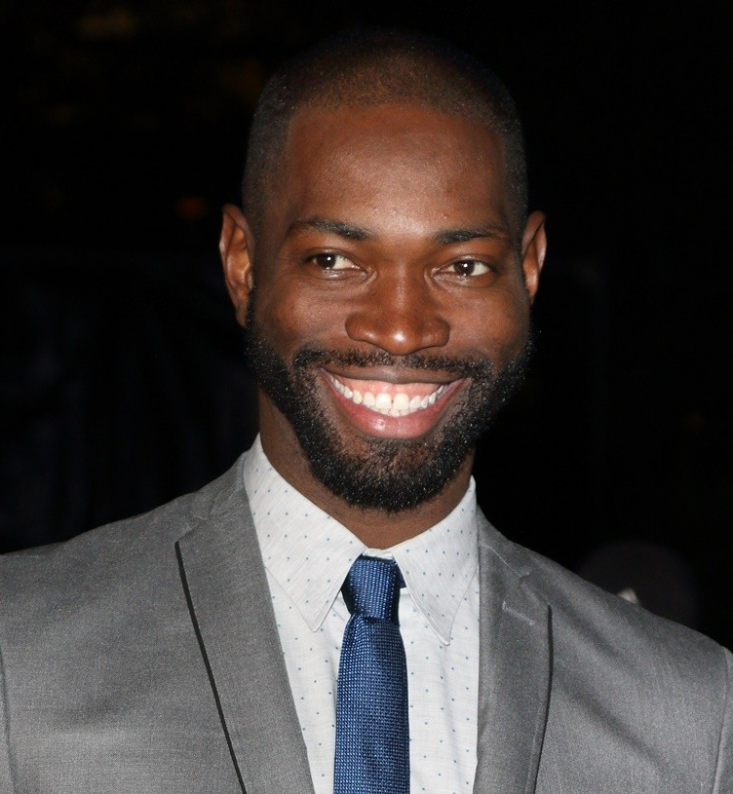
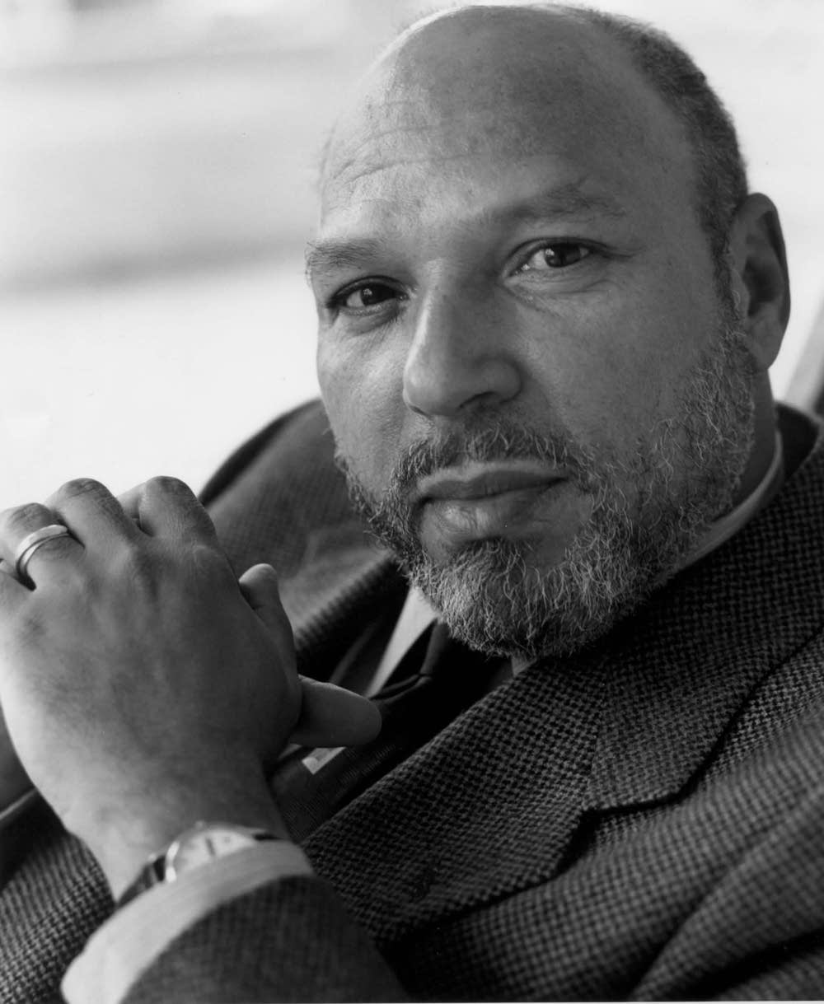
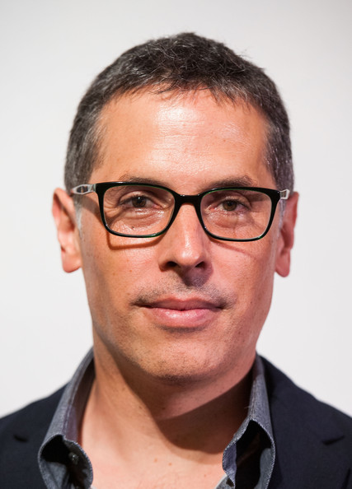
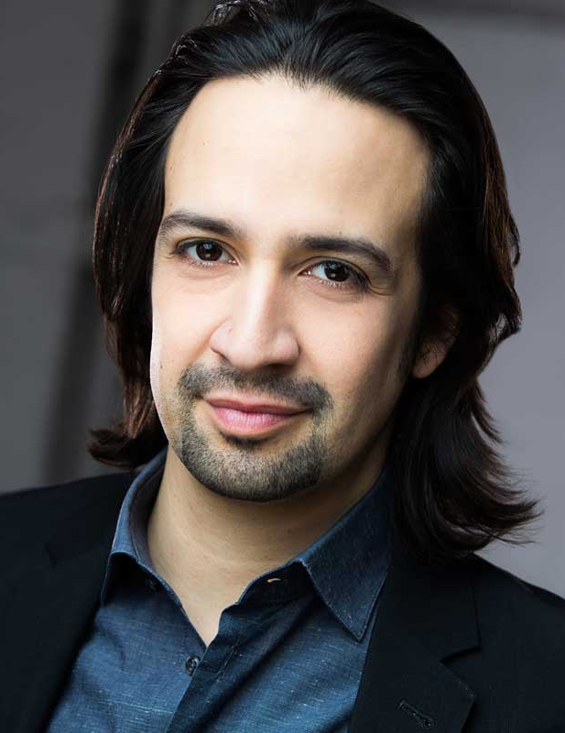
Best Screenplay
Asian Nominees
Latino Nominees

Slide 4
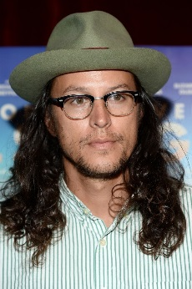
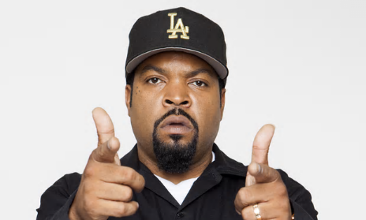
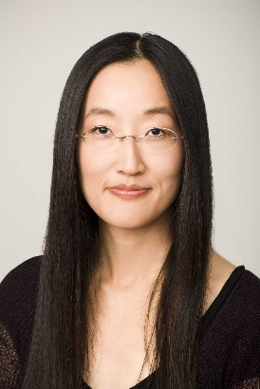
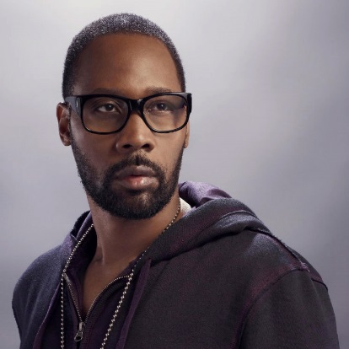
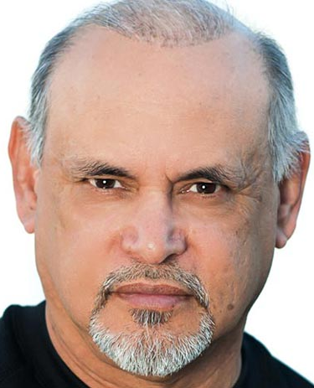
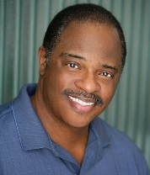
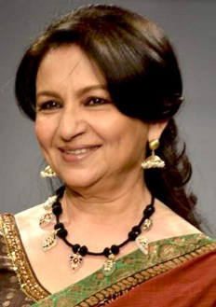
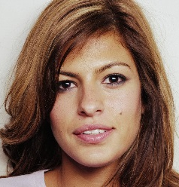
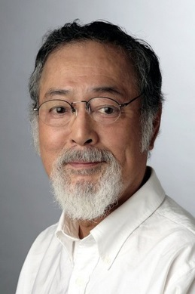
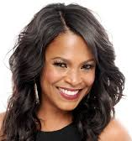
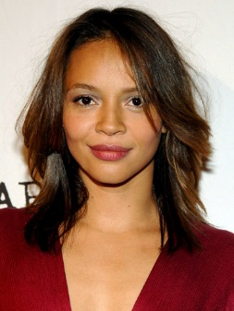
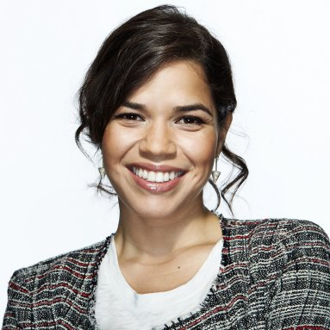
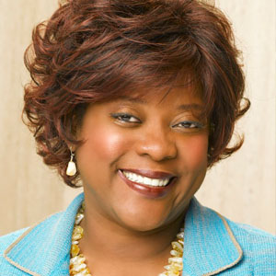
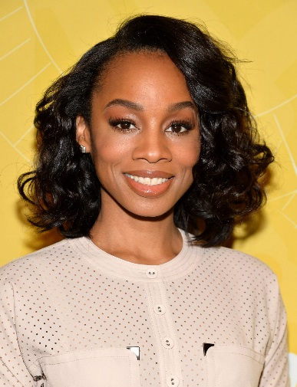
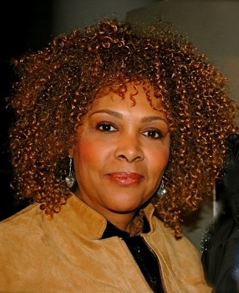
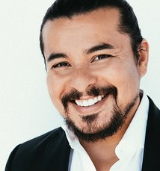
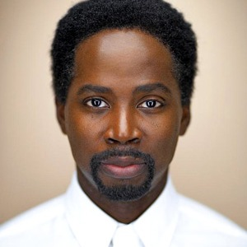
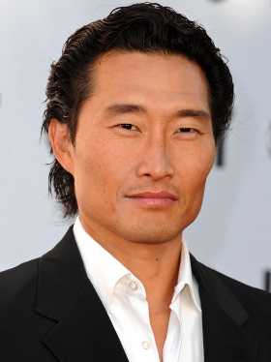
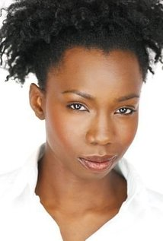
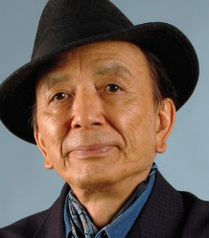
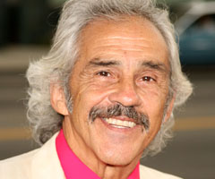
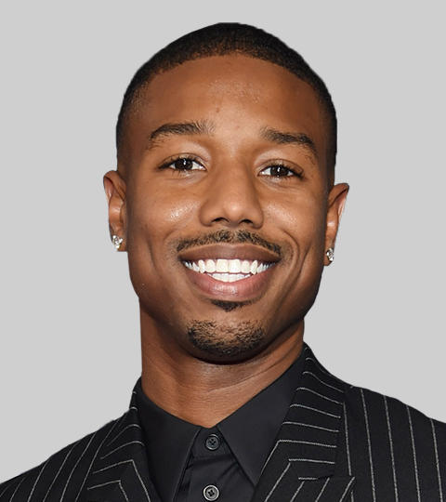
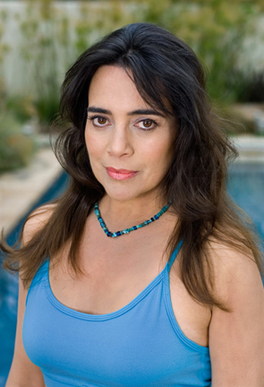
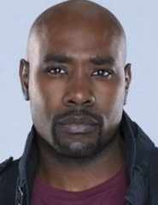
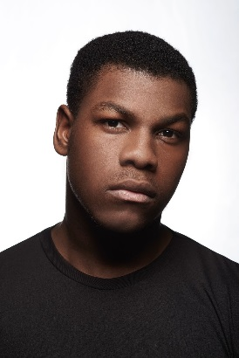
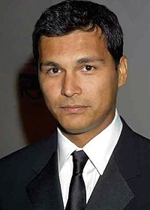
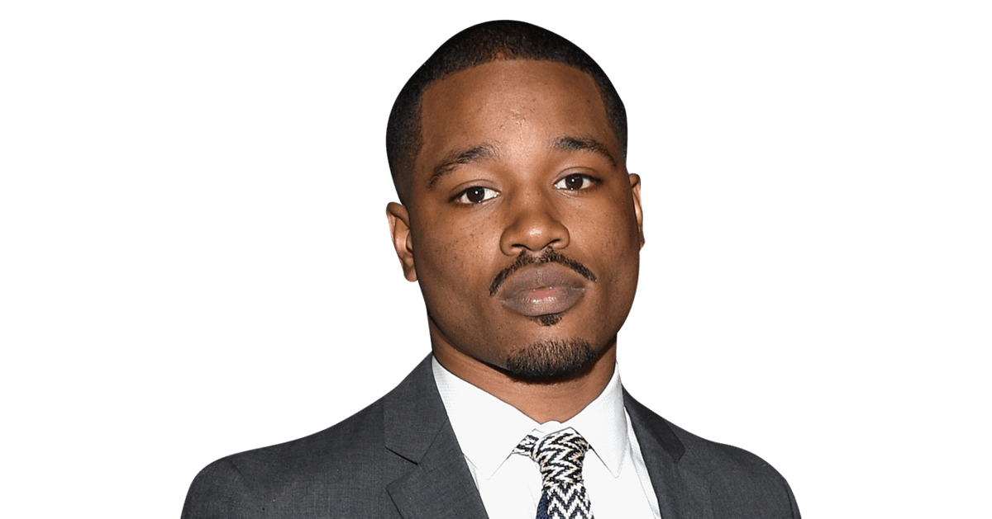

Slide 5
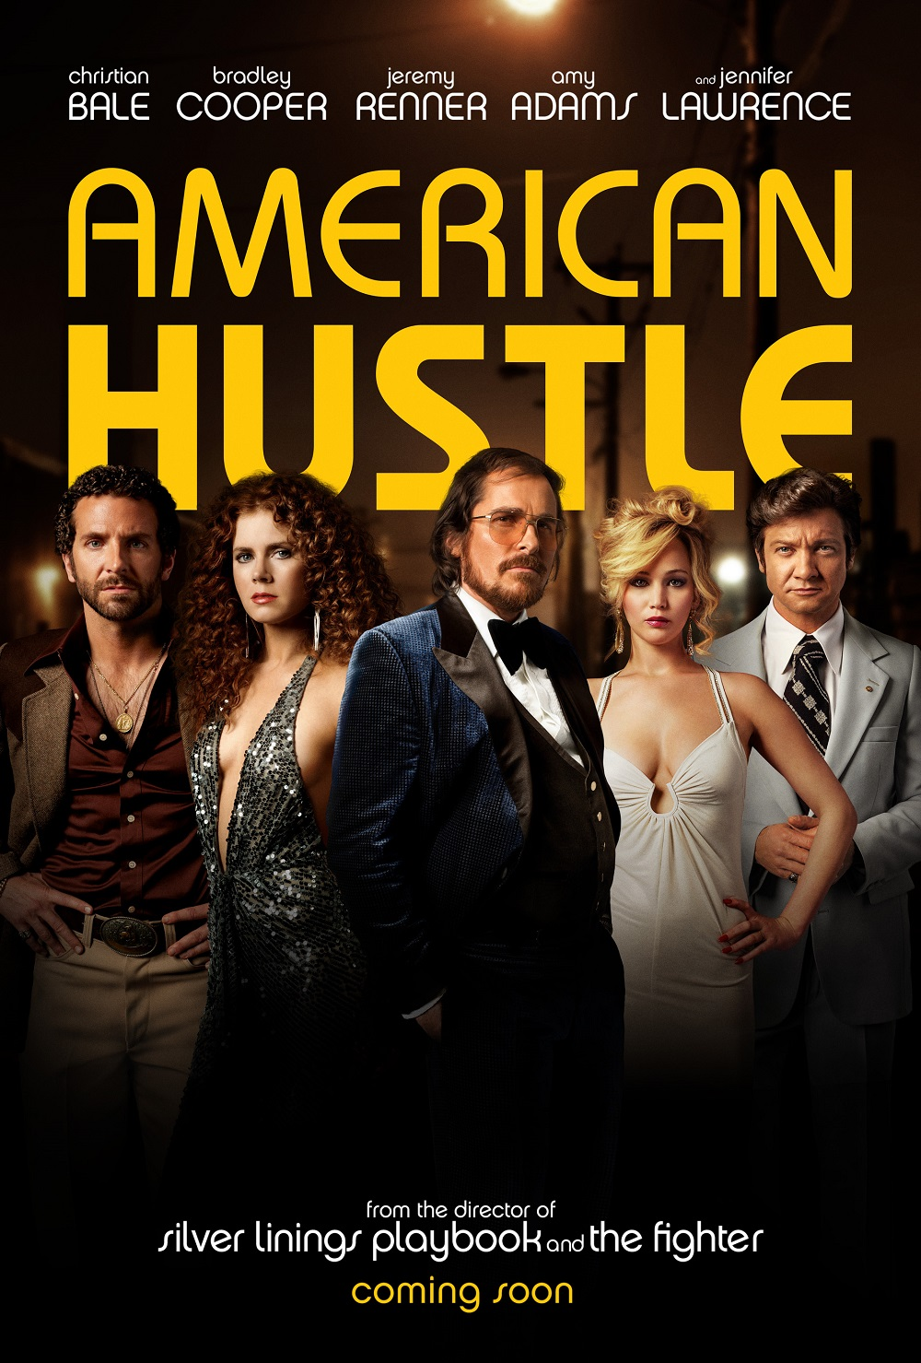

Slide 6
Women in Hollywood

Slide 7
Return on Investment
$1.5 million
$25 million
$20 Million+
$145 Million+

Slide 8
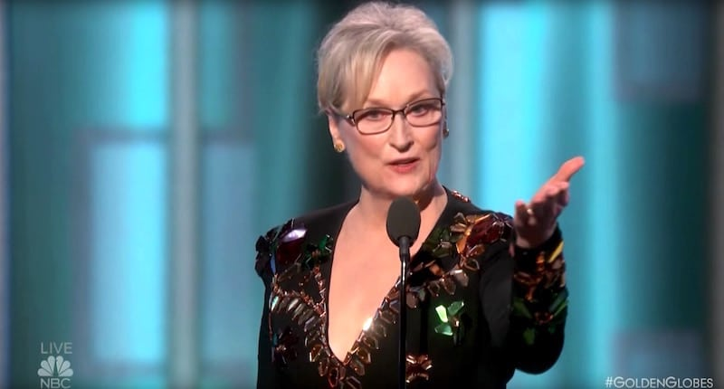
Politics at the Oscars

Slide 9
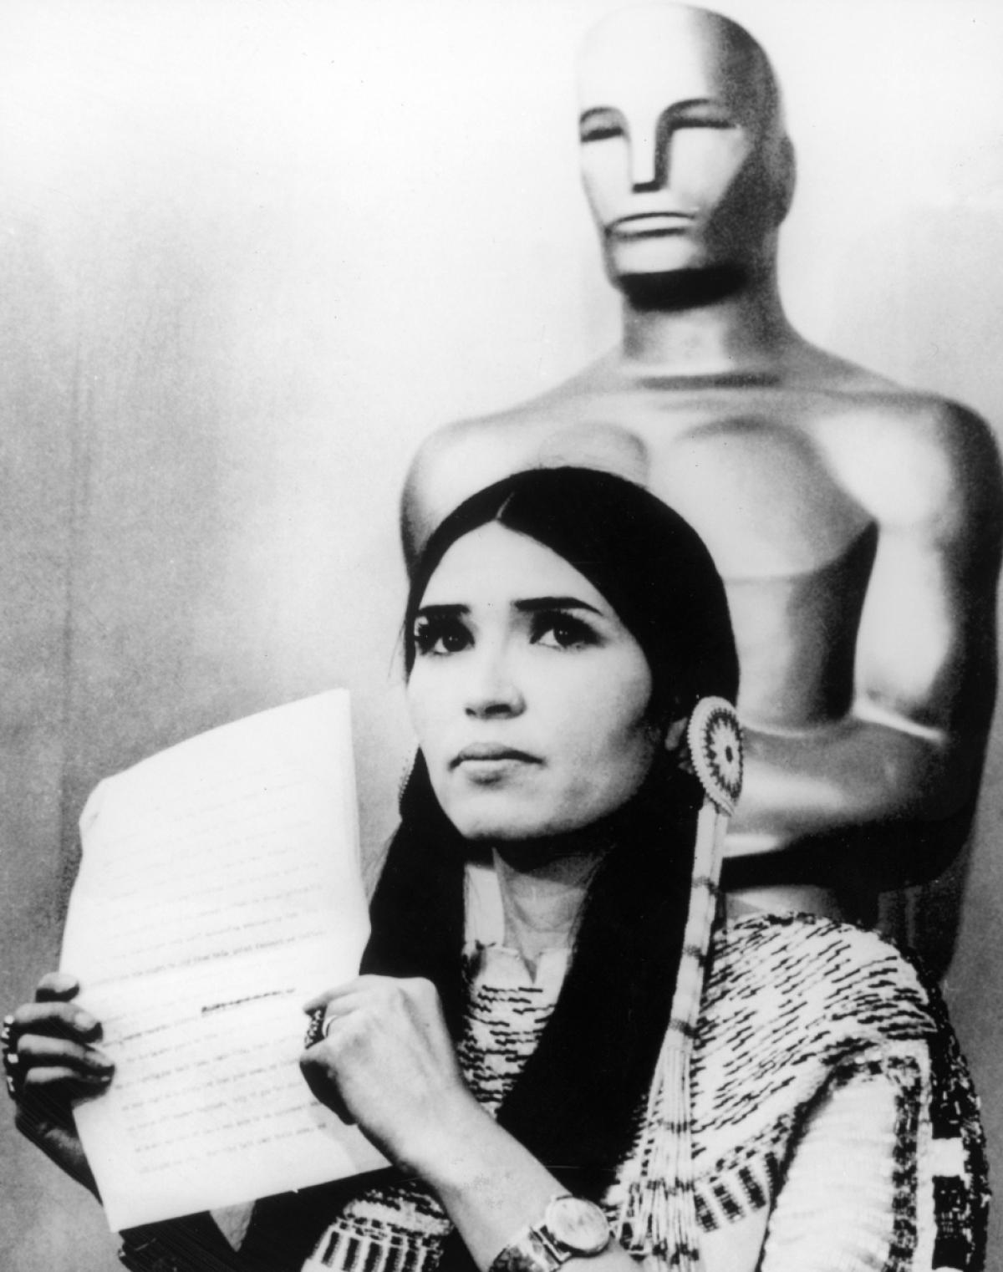
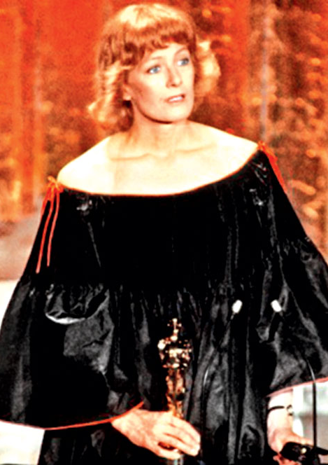
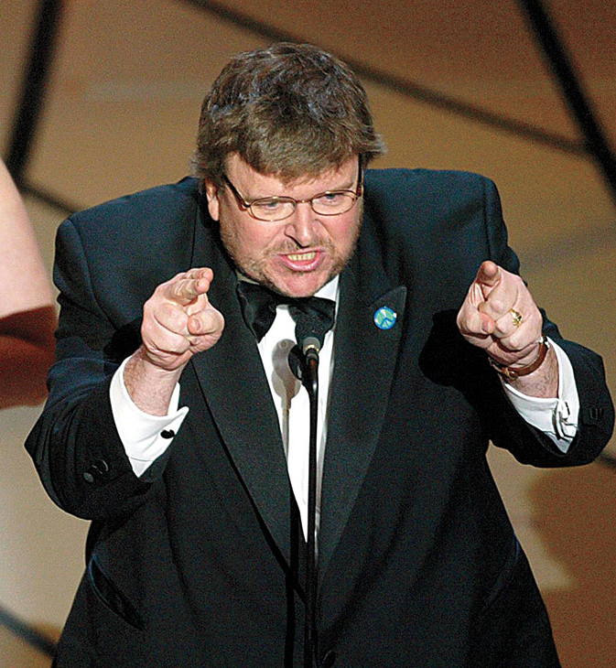
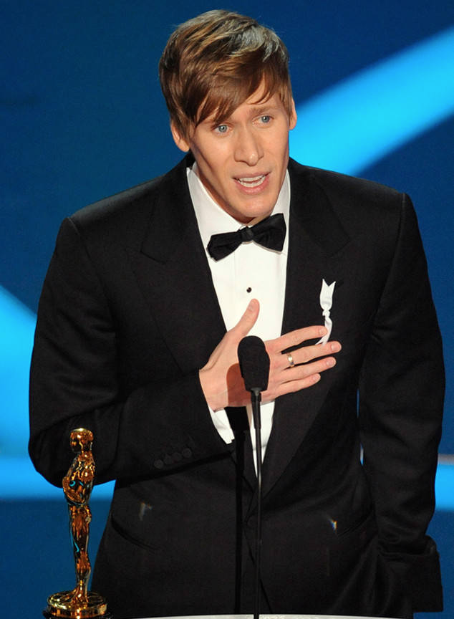
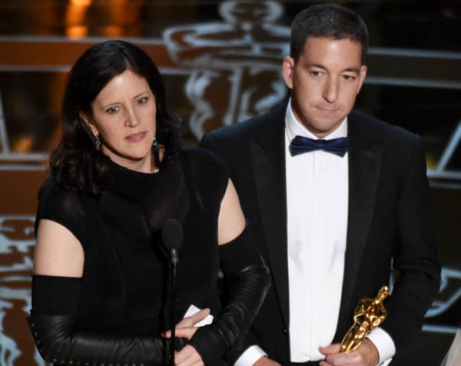
Politics at the Oscars

Slide 10
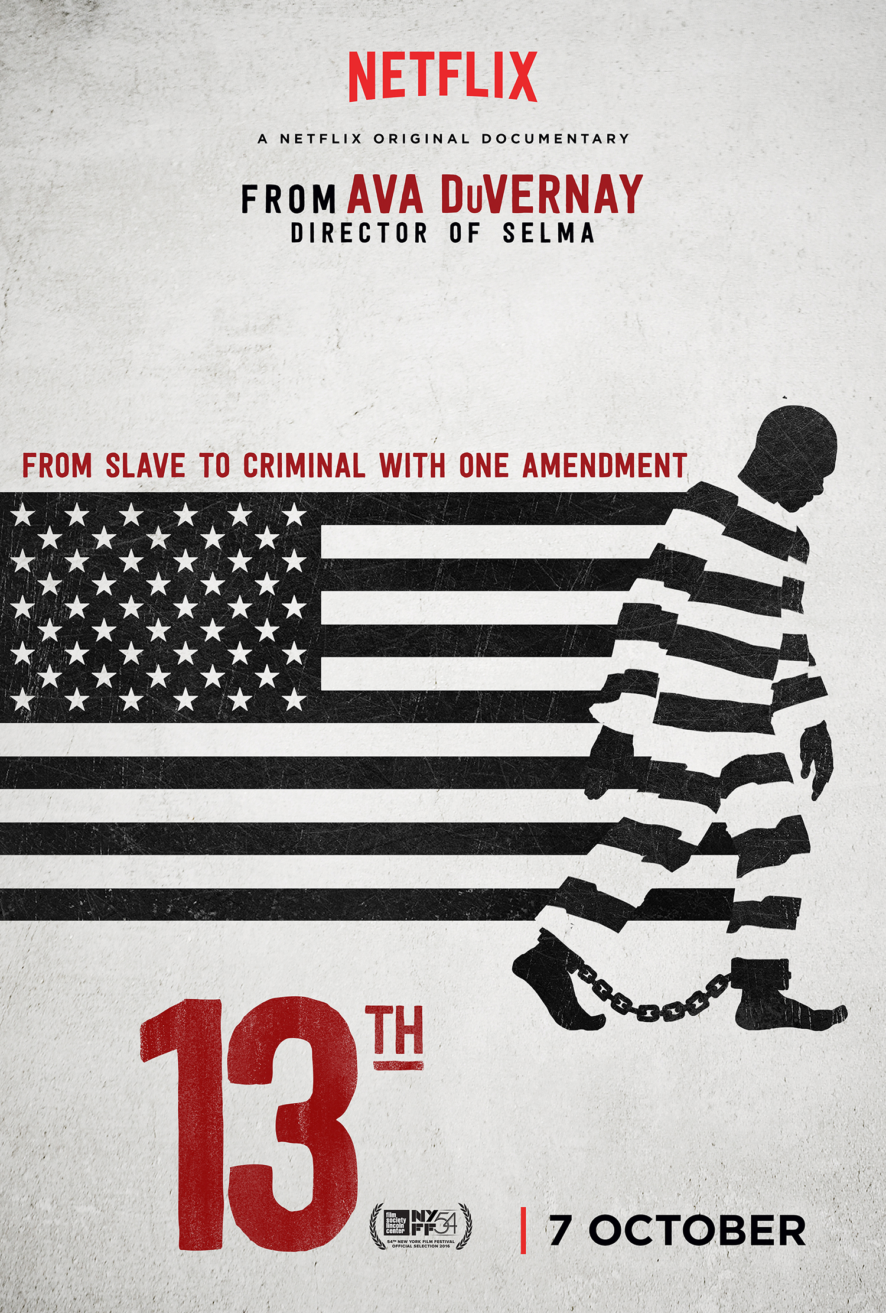
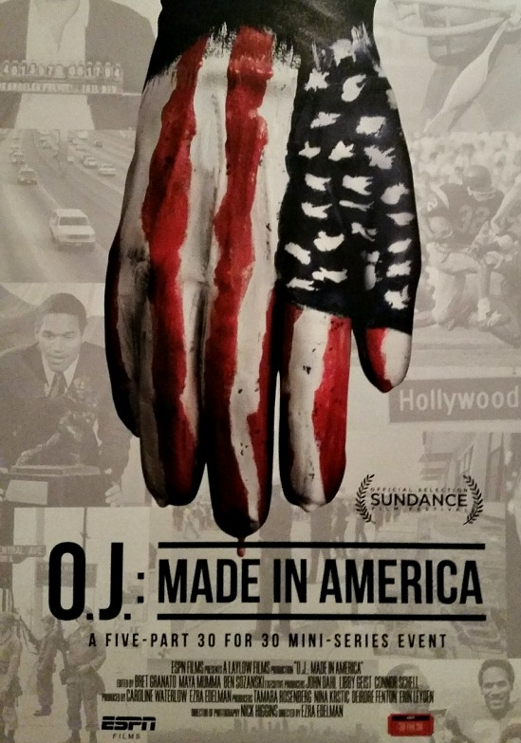
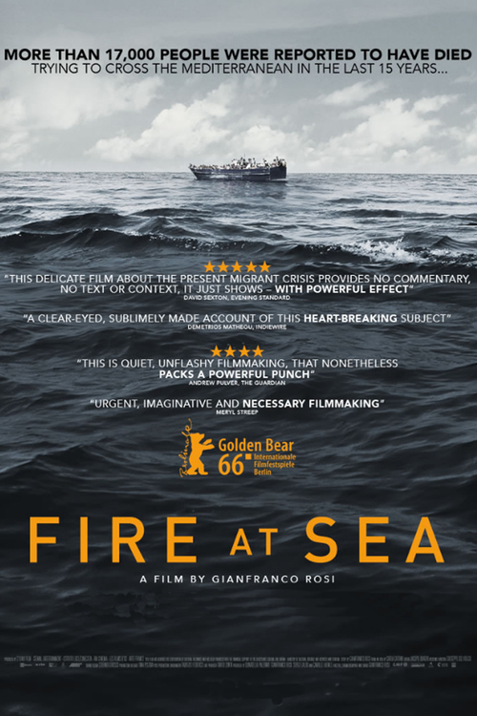
Best Documentary Feature
Notes:
13th (the betrayal of the 13th amendment)
O.J.: Made in America (7 hour TV documentary)
I Am Not Your Negro (bio-doc of author James Baldwin)
Fire at Sea (The opposition to Muslim refugees)

Slide 11
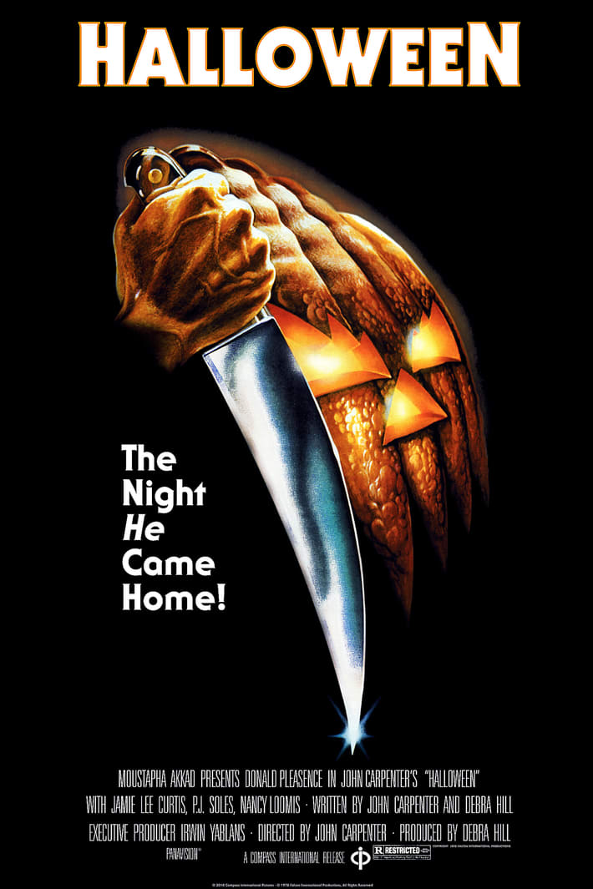
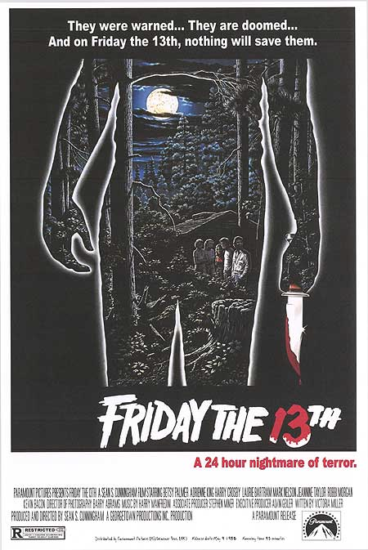
Escapist Entertainment

Slide 12
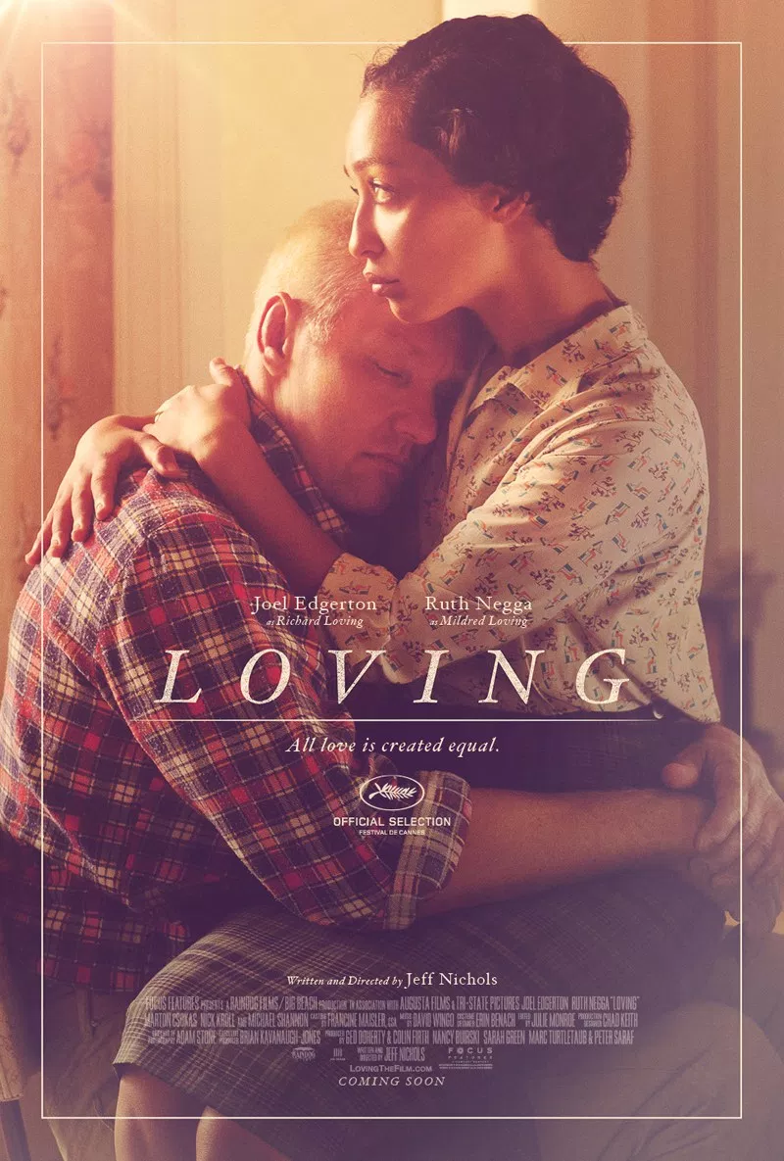

Slide 13
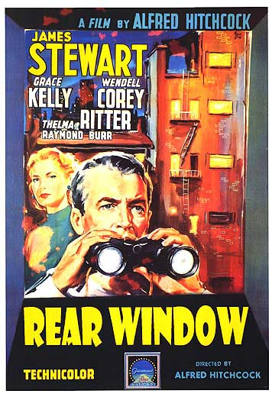
Red Scare Era
1950: Cinderella
1951: Quo Vadis
1952: The Greatest Show on Earth
1953: Peter Pan
1954: Rear Window

Slide 14
Civil Rights Era & Vietnam War Protests
1960: Swiss Family Robinson
1961: 101 Dalmatians
1962: The Longest Day
1963: Cleopatra
1964: Mary Poppins
1965: The Sound of Music
Notes:
1962: The Longest Day (about D-Day landings at Normandy)

Slide 15
Post 9/11
2002: Spider-Man
2003: The Lord of the Rings:
The Return of the King
2004: Shrek 2
2005: Star Wars: Episode III
Revenge of the Sith

Slide 16
Biopics

Slide 19
This Year’s Snubs
The Fits Directed By Anna Rose Holmer
Zootopia Directed By Byron Howard and Rich Moore
The Handmaiden Directed By Park Chan-wook
Loving Directed By Jeff Nichols
The Lobster Directed By Yorgos Lanthimos
13th Directed By Ava DuVernay
Moana Directed By John Musker and Ron Clements
Mountains May Depart Directed By Jia Zhangke
20th Century Women Directed by Mike Mills
I, Daniel Blake Directed By Ken Loach
Due to the size of the video clips, we were unable to include them in this presentation. All of the trailers are available via YouTube.

Slide 20
Other Notable Films:
Certain Women
Sunset Song
Elle
Silence
Toni Erdmann
American Honey
Paterson
Eye in The Sky
Kubo and the Two Strings
The Witch
Little Men

Slide 21
Directed By: Denis Villeneuve

Slide 22
Directed By: Denzel Washington

Slide 23
Directed By: David Mackenzie

Slide 24
Directed By: Theodore Melfi

Slide 25
Directed By: Barry Jenkins

Slide 26
Directed By: Garth Davis

Slide 27
Directed By: Mel Gibson

Slide 28
Directed By: Damien Chazelle

Slide 29
Directed By: Kenneth Lonergan

